Slide 1
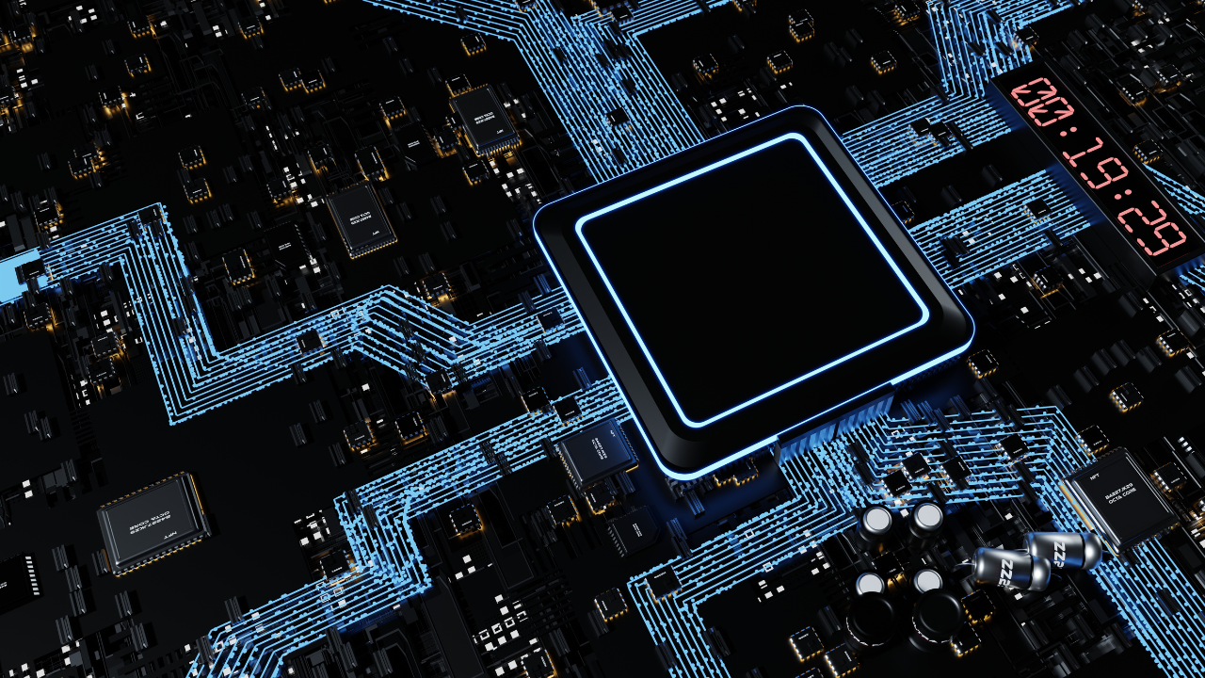

Lecture 7 – Transport Layer
COMPX234 | Irfan Ahmad | AI | Data Science | Computer Science
Ppts From Marinho Barcellos
Edited by Irfan Ahmad

Slide 2
Transport layer: overview
Our goal:
understand principles behind transport layer services:
multiplexing, demultiplexing
reliable data transfer
flow control
congestion control
learn about Internet transport layer protocols:
UDP: connectionless transport
TCP: connection-oriented reliable transport
TCP congestion control

Slide 3
Outlines
Transport-layer services
Multiplexing and demultiplexing
Connectionless transport: UDP
Principles of reliable data transfer
Stop-and-wait Protocols
Sliding Windows

Slide 4

Transport-layer Services

Slide 5
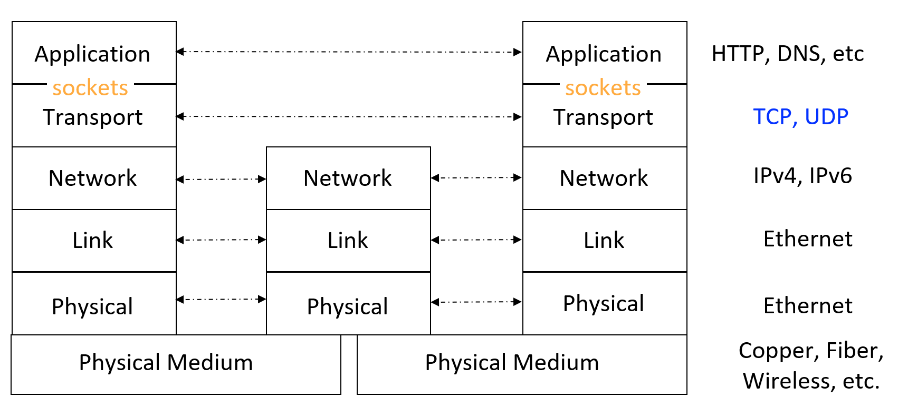
Recall the internet protocol layers

Slide 6

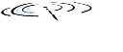

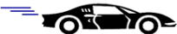


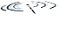






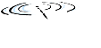


Transport services and protocols
application
transport
network
data link
physical
provide logical communication between application processes running on different hosts
mobile network
national or global ISP
transport protocols actions in end systems:
sender: breaks application messages into segments, passes to network layer
receiver: reassembles segments into messages, passes to application layer
logical end-end transport
local or regional ISP
home network
content
provider
network
application
transport
network
data link
physical
datacenter
network
two transport protocols available to Internet applications
TCP, UDP
enterprise
network

Slide 7
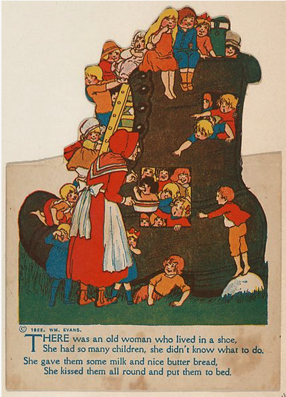
Transport vs. network layer services and protocols
household analogy:
12 kids in Ann’s house sending letters to 12 kids in Bill’s house:
hosts = houses
processes = kids
app messages = letters in envelopes
transport protocol = Ann and Bill who demux to in-house siblings
network-layer protocol = postal service

Slide 8
Transport vs. network layer services and protocols
transport layer: communication between processes
relies on, enhances, network layer services
household analogy:
12 kids in Ann’s house sending letters to 12 kids in Bill’s house:
hosts = houses
processes = kids
app messages = letters in envelopes
transport protocol = Ann and Bill who demux to in-house siblings
network-layer protocol = postal service
network layer: communication between hosts

Slide 9
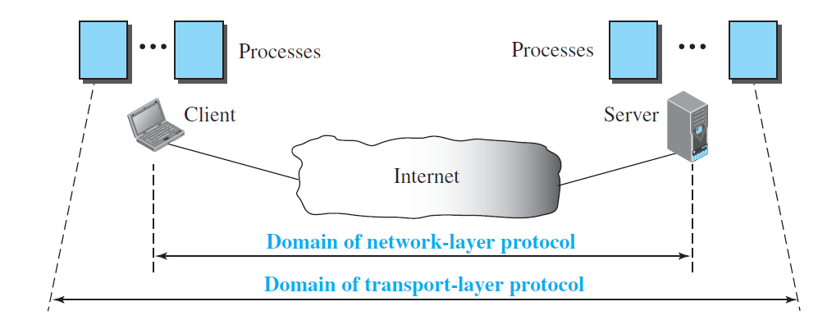
Transport vs. network layer services and protocols

Slide 10
Transport Layer Actions
Sender:
application
application
is given an application-layer message
app. msg
determines segment header fields values
T_{h}
transport
app. msg
transport
T_{h}
creates segment
network (IP)
network (IP)
passes segment to IP
link
link
physical
physical

Slide 11
Transport Layer Actions
Receiver:
application
receives segment from IP
application
checks header values
transport
transport
app. msg
extracts application-layer message
network (IP)
network (IP)
demultiplexes message up to application via socket
link
link
physical
physical
app. msg
T_{h}

Slide 12
Multiplexing and Demultiplexing

Slide 13





Suppose Firefox requests a page from Apache server
HTTP server
client
application
application
HTTP msg
transport
H_{t}
HTTP msg
H_{n}
H_{t}
network
transport
HTTP msg
transport
H_{n}
H_{t}
link
network
network
HTTP msg
link
physical
link
physical
physical
H_{n}
H_{t}
HTTP msg

Slide 14

Suppose Firefox requests a page from Apache server
client
application
application
HTTP msg
HTTP msg
transport
H_{t}
HTTP msg
transport
network
transport
network
link
network
link
physical
link
physical
physical
Q: how did transport layer know to deliver message to Firefox browser process rather then Netflix process or Skype process?

Slide 15
Multiplexing/demultiplexing
multiplexing as sender:
demultiplexing as receiver:
handle data from multiple
sockets, add transport header (later used for demultiplexing)
use header info to deliver
received segments to correct
socket
application
application
P1
P2
application
socket
P3
transport
P4
process
transport
network
transport
network
link
network
link
physical
link
physical
physical

Slide 16
Multiplexing/demultiplexing
application
?
transport
de-multiplexing

Slide 17
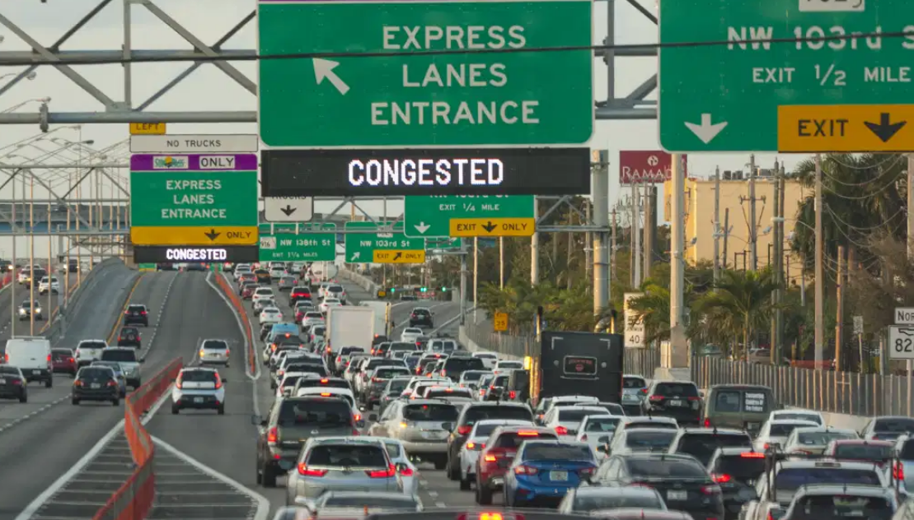
Multiplexing/demultiplexing
Demultiplexing

Slide 18
Multiplexing/demultiplexing
application
transport
multiplexing

Slide 19

Multiplexing/demultiplexing
Multiplexing

Slide 20
How demultiplexing works
host receives IP datagrams
each datagram has source IP address, destination IP address
each datagram carries one transport-layer segment
each segment has source, destination port number
host uses IP addresses & port numbers to direct segment to appropriate socket
32 bits
source port #
dest port #
other header fields
application
data
(payload)
TCP/UDP segment format

Slide 21
Connectionless demultiplexing
Recall:
when creating socket, must specify host-local port #:
DatagramSocket mySocket1 = new DatagramSocket(12534);
when receiving host receives UDP segment:
checks destination port # in segment
directs UDP segment to socket with that port #
when creating datagram to send into UDP socket, must specify
destination IP address
destination port #
IP/UDP datagrams with same dest. port #, but different source IP addresses and/or source port numbers will be directed to same socket at receiving host

Slide 22
Connectionless demultiplexing: an example
mySocket = socket(AF_INET,SOCK_DGRAM)
mySocket.bind(myaddr,6428);
mySocket = socket(AF_INET,SOCK_STREAM)
mySocket.bind(myaddr,9157);
mySocket = socket(AF_INET,SOCK_STREAM)
mySocket.bind(myaddr,5775);
application
application
P1
application
P3
P4
transport
transport
network
transport
network
link
network
link
physical
link
physical
physical
B
D
source port: 6428
dest port: 9157
source port: ?
dest port: ?
A
C
source port: 9157
dest port: 6428
source port: ?
dest port: ?

Slide 23
Connection-oriented demultiplexing
TCP socket identified by 4-tuple:
source IP address
source port number
dest IP address
dest port number
server may support many simultaneous TCP sockets:
each socket identified by its own 4-tuple
each socket associated with a different connecting client
demux: receiver uses all four values (4-tuple) to direct segment to appropriate socket

Slide 24
Connection-oriented demultiplexing: example
application
application
P4
P5
P6
application
P1
P2
P3
transport
transport
network
transport
network
link
network
link
physical
link
physical
server: IP address B
physical
host: IP address A
source IP,port: B,80
dest IP,port: A,9157
host: IP address C
source IP,port: C,5775
dest IP,port: B,80
source IP,port: A,9157
dest IP, port: B,80
source IP,port: C,9157
dest IP,port: B,80
Three segments, all destined to IP address: B,
dest port: 80 are demultiplexed to different sockets

Slide 25
Summary
Multiplexing, demultiplexing: based on segment, datagram header field values
UDP: demultiplexing using destination port number (only)
TCP: demultiplexing using 4-tuple: source and destination IP addresses, and port numbers
Multiplexing/demultiplexing happen at all layers

Slide 26

Connectionless Transport: UDP

Slide 27
UDP: User Datagram Protocol
“no frills,” “bare bones” Internet transport protocol
“best effort” service, UDP segments may be:
lost
delivered out-of-order to app
Why is there a UDP?
no connection establishment (which can add RTT delay)
simple: no connection state at sender, receiver
small header size
no congestion control
UDP can blast away as fast as desired!
can function in the face of congestion
connectionless:
no handshaking between UDP sender, receiver
each UDP segment handled independently of others

Slide 28
UDP: User Datagram Protocol
UDP use:
streaming multimedia apps (loss tolerant, rate sensitive)
DNS
SNMP
HTTP/3
if reliable transfer needed over UDP (e.g., HTTP/3):
add needed reliability at application layer
add congestion control at application layer

Slide 29
UDP: Transport Layer Actions
SNMP client
SNMP server
application
application
transport
(UDP)
transport
(UDP)
network (IP)
network (IP)
link
link
physical
physical

Slide 30
UDP: Transport Layer Actions
SNMP client
SNMP server
UDP sender actions:
application
application
is passed an application-layer message
SNMP msg
transport
(UDP)
transport
(UDP)
determines UDP segment header fields values
UDP_{h}
SNMP msg
UDP_{h}
creates UDP segment
network (IP)
network (IP)
passes segment to IP
link
link
physical
physical

Slide 31
UDP: Transport Layer Actions
SNMP client
SNMP server
UDP receiver actions:
application
receives segment from IP
application
checks UDP checksum header value
transport
(UDP)
transport
(UDP)
SNMP msg
extracts application-layer message
network (IP)
network (IP)
SNMP msg
UDP_{h}
demultiplexes message up to application via socket
link
link
physical
physical

Slide 32
UDP segment header
32 bits
source port #
dest port #
length
checksum
application
data
(payload)
length, in bytes of UDP segment, including header
data to/from application layer
UDP segment format

Slide 33

UDP checksum
Goal: detect errors (i.e., flipped bits) in transmitted segment
1st number
2nd number
sum
Transmitted: 5 6 11
Received: 4 6 11
receiver-computed
checksum
=
sender-computed
checksum (as received)

Slide 34
Internet checksum: an example
example: add two 16-bit integers
1 1 1 0 0 1 1 0 0 1 1 0 0 1 1 0
1 1 0 1 0 1 0 1 0 1 0 1 0 1 0 1
wraparound
1 1 0 1 1 1 0 1 1 1 0 1 1 1 0 1 1
sum
1 0 1 1 1 0 1 1 1 0 1 1 1 1 0 0
checksum
0 1 0 0 0 1 0 0 0 1 0 0 0 0 1 1
Note: when adding numbers, a carryout from the most significant bit needs to be added to the result
* Check out the online interactive exercises for more examples: http://gaia.cs.umass.edu/kurose_ross/interactive/

Slide 35
Internet checksum: weak protection!
example: add two 16-bit integers
0 1
1 1 1 0 0 1 1 0 0 1 1 0 0 1 1 0
1 0
1 1 0 1 0 1 0 1 0 1 0 1 0 1 0 1
wraparound
1 1 0 1 1 1 0 1 1 1 0 1 1 1 0 1 1
Even though numbers have changed (bit flips), no change in checksum!
sum
1 0 1 1 1 0 1 1 1 0 1 1 1 1 0 0
checksum
0 1 0 0 0 1 0 0 0 1 0 0 0 0 1 1

Slide 36
Summary: UDP
“no frills” protocol:
segments may be lost, delivered out of order
best effort service: “send and hope for the best”
UDP has its plusses:
no setup/handshaking needed (no RTT incurred)
can function when network service is compromised
helps with reliability (checksum)
build additional functionality on top of UDP in application layer (e.g., HTTP/3)

Slide 37

Principles of Reliable Data Transfer

Slide 38
Principles of reliable data transfer
sending process
receiving process
application
data
data
transport
reliable channel
reliable service abstraction

Slide 39
Principles of reliable data transfer
sending process
receiving process
sending process
receiving process
application
data
data
application
data
data
transport
transport
reliable channel
sender-side of
reliable data transfer protocol
receiver-side
of reliable data transfer protocol
reliable service abstraction
transport
network
unreliable channel
reliable service implementation

Slide 40
Principles of reliable data transfer
sending process
receiving process
application
data
data
transport
sender-side of
reliable data transfer protocol
receiver-side
of reliable data transfer protocol
Complexity of reliable data transfer protocol will depend (strongly) on characteristics of unreliable channel (lose, corrupt, reorder data?)
transport
network
unreliable channel
reliable service implementation

Slide 41

Principles of reliable data transfer
sending process
receiving process
application
data
data
transport
Sender, receiver do not know the “state” of each other, e.g., was a message received?
unless communicated via a message
sender-side of
reliable data transfer protocol
receiver-side
of reliable data transfer protocol
transport
network
unreliable channel
reliable service implementation

Slide 42
Principles of reliable data transfer
Let’s incrementally add reliability to protocol, so that it deals with the problems

Slide 43

Reliable transfer over a reliable channel
Sender just transmits a packet, and it will get at the receiver
Packet is never corrupted
Packet is never lost
Packet arrives within a finite amount of time (eventually)
There is never a problem 🙂
If so, the reliable protocol does not need to do anything
This is not so crazy… 🙂 it is possible that reliability is provided by some lower layer
Like from Web HTTP point-of-view, this is like what TCP provides!

Slide 44
A channel with bit errors
underlying channel may flip bits in packet
checksum (e.g., Internet checksum) to detect bit errors
the question: how to recover from errors?
How do humans recover from “errors” during conversation?

Slide 45
A channel with bit errors
underlying channel may flip bits in packet
checksum to detect bit errors
the question: how to recover from errors?
acknowledgements (ACKs): receiver explicitly tells sender that pkt received OK
negative acknowledgements (NAKs): receiver explicitly tells sender that pkt had errors
sender retransmits pkt on receipt of NAK
stop and wait
sender sends one packet, then waits for receiver response

Slide 46
A channel with bit errors
what happens if ACK/NAK corrupted?
sender doesn’t know what happened at receiver!
can’t just retransmit: possible duplicate
handling duplicates:
sender retransmits current pkt if ACK/NAK corrupted
sender adds sequence number to each pkt
receiver discards (doesn’t deliver up) duplicate pkt
stop and wait
sender sends one packet, then waits for receiver response

Slide 47
A channel with bit errors and losses (rdt3.0)
New channel assumption: underlying channel can also lose packets (data, ACKs)
checksum, sequence #s, ACKs, retransmissions will be of help … but not quite enough
Q: How do humans handle lost sender-to-receiver words in conversation?

Slide 48

A channel with bit errors and losses (rdt3.0)
Approach: sender waits “reasonable” amount of time for ACK
retransmits if no ACK received in this time
if pkt (or ACK) just delayed (not lost):
retransmission will be duplicate, but seq #s already handles this!
receiver must specify seq # of packet being ACKed
use countdown timer to interrupt after “reasonable” amount of time
timeout

Slide 49
Reliability mechanisms - (rdt3.0) summary
Checksums to detect packet corruption, in both directions!
Negative confirmations (NACKs) sent by receiver to inform sender that packet was received with error
Retransmissions to recover from errors
Positive confirmations (ACKs) sent by receiver to inform the sender that packet was received correctly
Sequence numbers to identify data and deal with duplicates

Slide 50
Reliability mechanisms - (rdt3.0) summary
Timeouts at the sender to deal with loss of packets transmitted to the receiver
How about lost ACKs/NACKs, what happens?
Stop and wait!
Can the protocol use only ACKs, and silently discard any corrupted packets?
What if there is no feedback channel? Can the sender simply send several times the same data?

Slide 51

Stop-and-wait Protocols

Slide 52

rdt3.0 in action: Stop-and-wait protocol operation
sender
receiver
sender
receiver
send pkt0
pkt0
send pkt0
pkt0
rcv pkt0
rcv pkt0
ack0
send ack0
ack0
send ack0
rcv ack0
rcv ack0
send pkt1
pkt1
send pkt1
pkt1
rcv pkt1
X
ack1
send ack1
loss
rcv ack1
send pkt0
pkt0
rcv pkt0
timeout
resend pkt1
ack0
send ack0
pkt1
rcv pkt1
ack1
send ack1
rcv ack1
send pkt0
pkt0
(a) no loss
rcv pkt0
ack0
send ack0
(b) packet loss

Slide 53
rdt3.0 in action: stop-and-wait protocol operation
sender
receiver
sender
receiver
send pkt0
pkt0
rcv pkt0
send pkt0
pkt0
send ack0
rcv pkt0
rcv ack0
ack0
ack0
send ack0
send pkt1
pkt1
rcv ack0
rcv pkt1
send pkt1
pkt1
send ack1
rcv pkt1
ack1
ack1
send ack1
X
timeout
resend pkt1
loss
pkt1
rcv pkt1
timeout
resend pkt1
rcv ack1
(detect duplicate)
pkt1
rcv pkt1
send ack1
send pkt0
pkt0
ack1
(detect duplicate)
rcv pkt0
rcv ack1
send ack1
rcv ack1
ack1
ack0
send ack0
send pkt0
pkt0
(ignore)
rcv pkt0
ack0
send ack0
pkt1
(c) ACK loss
(d) premature timeout/ delayed ACK

Slide 54
rdt3.0: stop-and-wait performance
U _{sender}: utilization – fraction of time sender busy sending
example: 1 Gbps link, 15 ms prop. delay, 8000 bit packet
time to transmit packet into channel:
L
8000 bits
D_{trans} =
=
=
8 microsecs
R
10⁹ bits/sec

Slide 55
rdt3.0: stop-and-wait operation
sender
receiver
first packet bit transmitted, t = 0
first packet bit arrives
RTT
last packet bit arrives, send ACK
ACK arrives, send next
packet, t = RTT + L / R

Slide 56
rdt3.0: stop-and-wait operation
sender
receiver
L / R
=
L/R
U_{sender}
RTT
+ L / R
.008
RTT
=
30.008
=
0.00027
rdt 3.0 (stop-and-wait operation) protocol performance stinks!
Protocol limits performance of underlying infrastructure (channel)

Slide 57
Sliding Windows

Slide 58
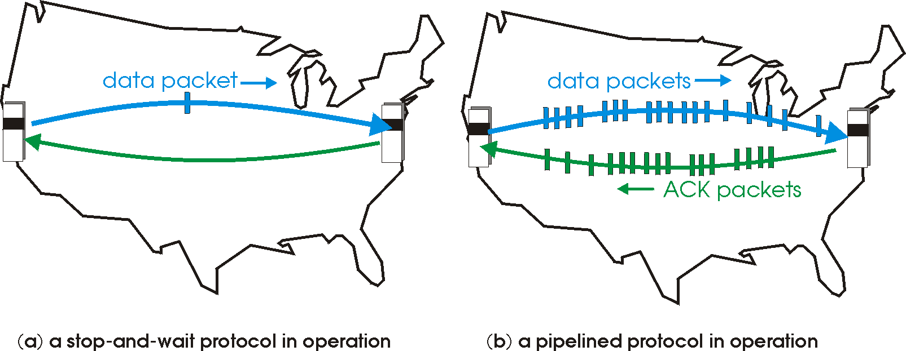
rdt3.0: From stop-and-wait to sliding window protocols
Sliding window/pipelining: sender allows multiple, “in-flight”, yet-to-be-acknowledged packets
range of sequence numbers must be increased
buffering at sender and/or receiver

Slide 59
Sliding window protocols: increased utilization
sender
receiver
first packet bit transmitted, t = 0
last bit transmitted, t = L / R
first packet bit arrives
RTT
last packet bit arrives, send ACK
last bit of 2nd packet arrives, send ACK
last bit of 3rd packet arrives, send ACK
ACK arrives, send next
packet, t = RTT + L / R
3-packet pipelining increases
utilization by a factor of 3!

Slide 60
Sliding window protocols: two types
Go-back-N | Selective Repeat
Sender can have up to N unACKed packets in flight | Sender can have up to N unACKed packets in flight
Receiver only sends "cumulative" ACKs, and does not send ACK if there’s a gap in sequence | Receiver sends individual ACK for each packet
Sender has (single) timer, for oldest unacked packet | Sender maintains one timer for each unACKed packet
When timer expires, sender retransmits all unACKed packets | When timer expires, retransmit only that unACKed packet

Slide 61
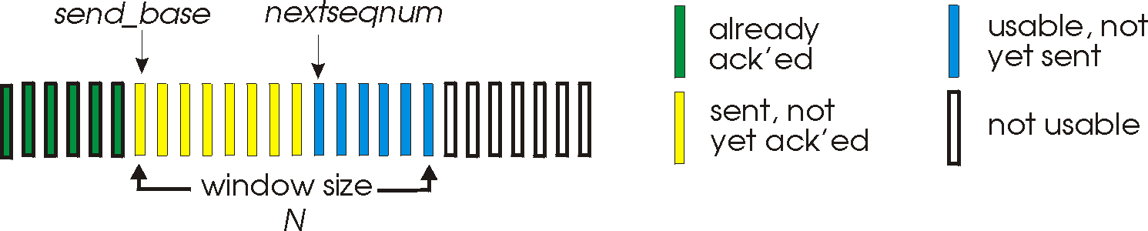
Go-Back-N: sender
sender: “window” of up to N, consecutive transmitted but unACKed pkts
Sender places a seq # in packet header to identify the data
cumulative ACK: ACK(n): ACKs all packets up to, including seq # n
On receiving packet ACK(n): sender slides window forward to start at n+1.
Sender keeps a timer for oldest "in-flight packet”, i.e. unACKed
When there is a timeout (at the sender), the sender retransmits oldest unconfirmed packet and all other subsequent packets (higher seq) in window

Slide 62
Go-Back-N: receiver
ACK-only: always send ACK for correctly-received packet so far, with highest in-order packet
may generate duplicate ACKs
need only remember rcv_base
on receipt of out-of-order packet:
can discard (don’t buffer) or buffer: an implementation decision
re-ACK pkt with highest in-order seq #
Receiver view of sequence number space:
received and ACKed
…
…
Out-of-order: received but not ACKed
rcv_base
Not received

Slide 63
Go-Back-N in action
sender window (N=4)
sender
receiver
0 1 2 3 4 5 6 7 8
send pkt0
send pkt1
send pkt2
send pkt3
(wait)
0 1 2 3 4 5 6 7 8
receive pkt0, send ack0
receive pkt1, send ack1
receive pkt3, discard,
(re)send ack1
0 1 2 3 4 5 6 7 8
X
0 1 2 3 4 5 6 7 8
loss
0 1 2 3 4 5 6 7 8
rcv ack0, send pkt4
0 1 2 3 4 5 6 7 8
rcv ack1, send pkt5
receive pkt4, discard,
(re)send ack1
ignore duplicate ACK
receive pkt5, discard,
(re)send ack1
pkt 2 timeout
0 1 2 3 4 5 6 7 8
send pkt2
send pkt3
send pkt4
send pkt5
0 1 2 3 4 5 6 7 8
0 1 2 3 4 5 6 7 8
rcv pkt2, deliver, send ack2
rcv pkt3, deliver, send ack3
rcv pkt4, deliver, send ack4
rcv pkt5, deliver, send ack5
0 1 2 3 4 5 6 7 8

Slide 64
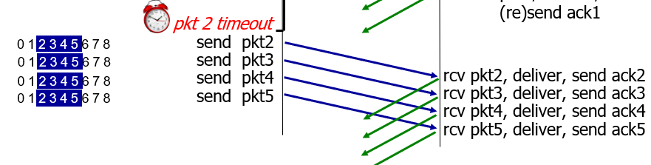
Go-Back-N in action
This looks inefficient, but if the receiver discards packets, then it’s necessary

Slide 65
Selective repeat: the approach
Window/pipelining: multiple packets in flight
receiver individually ACKs all correctly received packets
buffers packets, as needed, for in-order delivery to application layer
sender:
maintains (conceptually) a timer for each unACKed pkt
timeout: retransmits single unACKed packet associated with timeout
maintains (conceptually) “window” over N consecutive seq #s
Window limits the sequence numbers of packets sent, according to unACKed packets

Slide 66
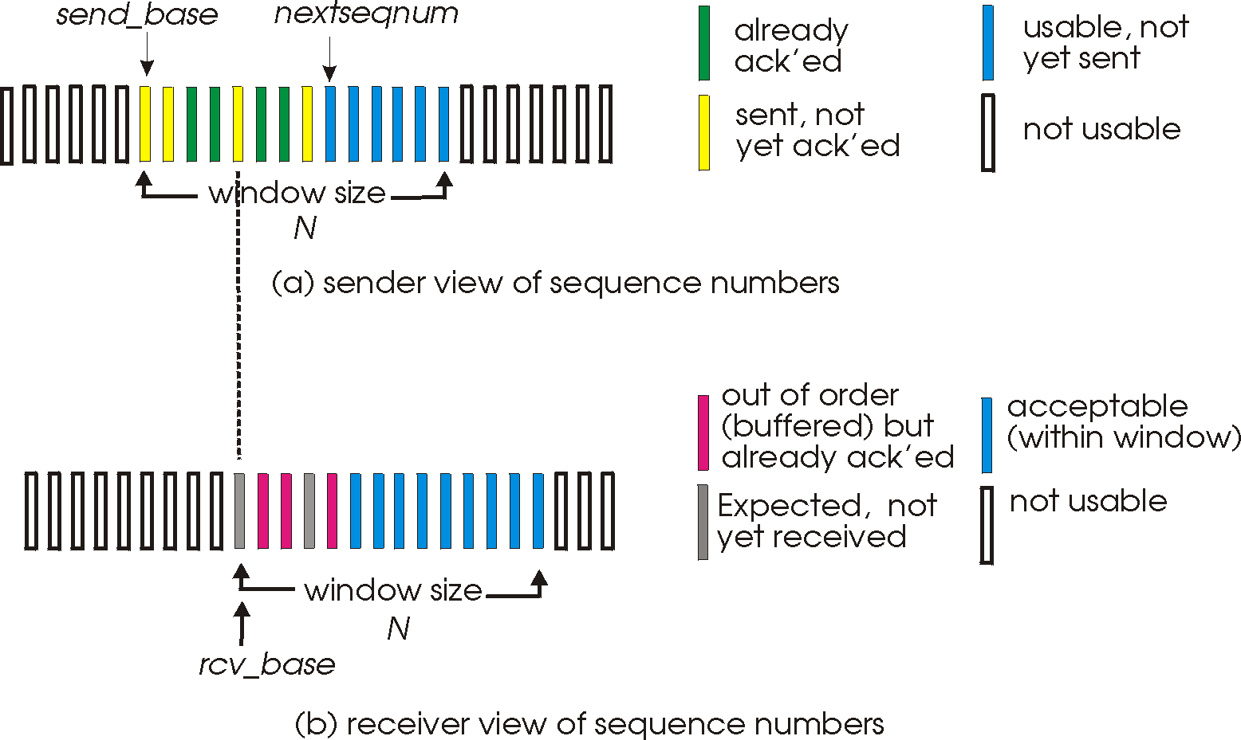
Selective repeat: sender, receiver windows

Slide 67
Selective Repeat in action
sender window (N=4)
sender
receiver
0 1 2 3 4 5 6 7 8
send pkt0
send pkt1
send pkt2
send pkt3
(wait)
0 1 2 3 4 5 6 7 8
receive pkt0, send ack0
receive pkt1, send ack1
receive pkt3, buffer,
send ack3
0 1 2 3 4 5 6 7 8
X
0 1 2 3 4 5 6 7 8
loss
0 1 2 3 4 5 6 7 8
rcv ack0, send pkt4
0 1 2 3 4 5 6 7 8
rcv ack1, send pkt5
receive pkt4, buffer,
send ack4
record ack3 arrived
receive pkt5, buffer,
send ack5
pkt 2 timeout
0 1 2 3 4 5 6 7 8
send pkt2
(but not 3,4,5)
0 1 2 3 4 5 6 7 8
0 1 2 3 4 5 6 7 8
rcv pkt2; deliver pkt2,
pkt3, pkt4, pkt5; send ack2
0 1 2 3 4 5 6 7 8
Q: what happens when ack2 arrives?

Slide 68
Connection-oriented Transport: TCP

Slide 69
TCP: overview
point-to-point:
one sender, one receiver
reliable, in-order byte steam:
no “message boundaries"
full duplex data:
bi-directional data flow in same connection
MSS: maximum segment size
cumulative ACKs
pipelining:
TCP congestion and flow control set window size
connection-oriented:
client and sender do handshake before exchanging data
flow controlled:
sender will not overwhelm receiver

Slide 70
TCP segment structure
32 bits
source port #
dest port #
segment seq #: counting bytes of data into bytestream (not segments!)
ACK: seq # of next expected byte; A bit: this is an ACK
sequence number
acknowledgement number
length (of TCP header)
head
len
not
used
A
P
S
receive window
flow control: # bytes receiver willing to accept
C
E
U
R
F
Internet checksum
checksum
Urg data pointer
options (variable length)
C, E: congestion notification
TCP options
application
data
(variable length)
data sent by application into TCP socket
RST, SYN, FIN: connection management

Slide 71
TCP sequence numbers, ACKs
outgoing segment from sender
Sequence numbers:
byte stream “number” of first byte in segment’s data
source port #
dest port #
sequence number
acknowledgement number
rwnd
checksum
urg pointer
window size
N
Acknowledgements:
seq # of next byte expected from other side
cumulative ACK
sender sequence number space
sent
ACKed
sent, not-yet ACKed
(“in-flight”)
usable
but not
yet sent
not
usable
Q: how receiver handles out-of-order segments
A: TCP spec doesn’t say, - up to implementor
outgoing segment from receiver
source port #
dest port #
sequence number
acknowledgement number
A
rwnd
checksum
urg pointer

Slide 72
TCP sequence numbers, ACKs
Host A
Host B
A transmits packet with 100 bytes
B gets packet with 100 bytes of data from A.
B sends confirmation of receipt of these 100bytes and in the same packet, sends 10 bytes
to A
Seq=40, ACK=70, data = ‘100B’
A gets confirmation that the 100bytes were received by B, and A also
receives 10 bytes of data from B
Seq=70, ACK=140, data = ’10B’
Seq=140, ACK=80
Now B knows that A has received up to 79 and is expecting 80 next
Bi-directional!

Slide 73
TCP connection management
before exchanging data, sender/receiver “handshake”:
agree to establish connection (each knowing the other willing to establish connection)
agree on connection parameters (e.g., starting seq #s)
application
application
connection state: ESTAB
connection variables:
seq # client-to-server
server-to-client
rcvBuffer size
at server,client
connection state: ESTAB
connection Variables:
seq # client-to-server
server-to-client
rcvBuffer size
at server,client
network
network
Socket clientSocket =
newSocket("hostname","port number");
Socket connectionSocket = welcomeSocket.accept();

Slide 74
TCP 3-way handshake
Server state
Client state
serverSocket = socket(AF_INET,SOCK_STREAM)
serverSocket.bind((‘’,serverPort))
serverSocket.listen(1)
connectionSocket, addr = serverSocket.accept()
clientSocket = socket(AF_INET, SOCK_STREAM)
LISTEN
clientSocket.connect((serverName,serverPort))
LISTEN
choose init seq num, x
send TCP SYN msg
SYNSENT
SYNbit=1, Seq=x
choose init seq num, y
send TCP SYNACK
msg, acking SYN
SYN RCVD
SYNbit=1, Seq=y
ACKbit=1; ACKnum=x+1
received SYNACK(x)
indicates server is live;
send ACK for SYNACK;
this segment may contain
client-to-server data
ESTAB
ACKbit=1, ACKnum=y+1
received ACK(y)
indicates client is live
ESTAB

Slide 75
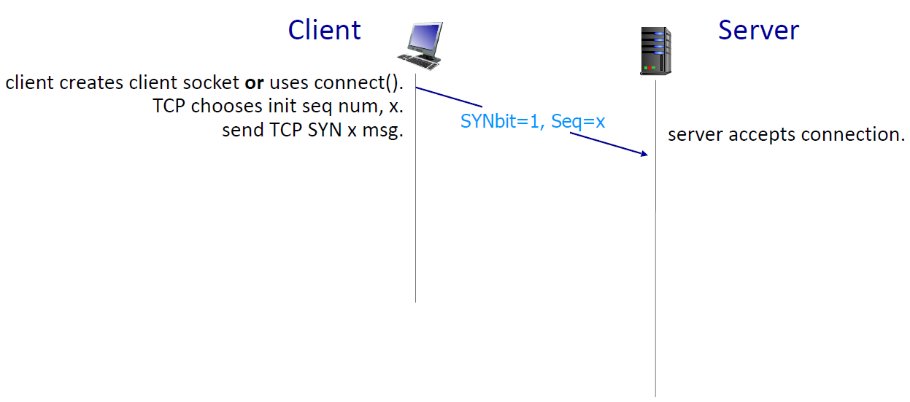
TCP 3-way handshake

Slide 76
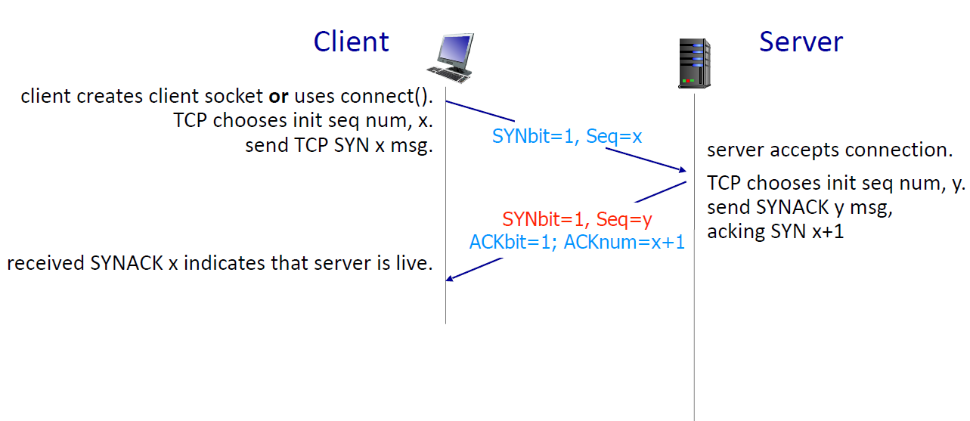
TCP 3-way handshake

Slide 77
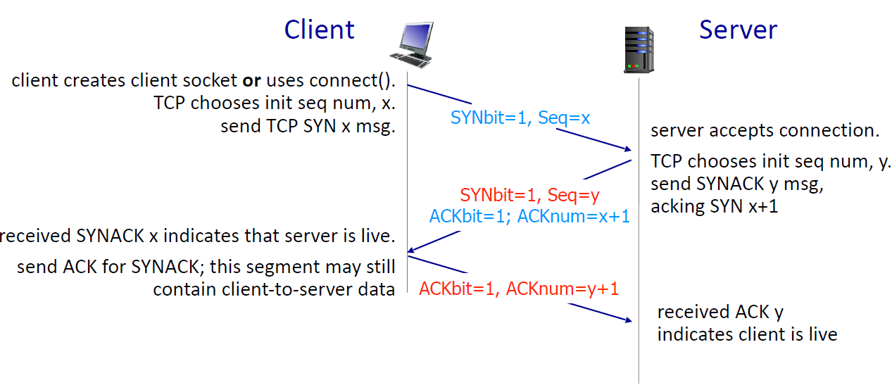
TCP 3-way handshake

Slide 78
Closing a TCP connection
client, server each close their side of connection
send TCP segment with FIN bit = 1
respond to received FIN with ACK
on receiving FIN, ACK can be combined with own FIN
simultaneous FIN exchanges can be handled

Slide 79
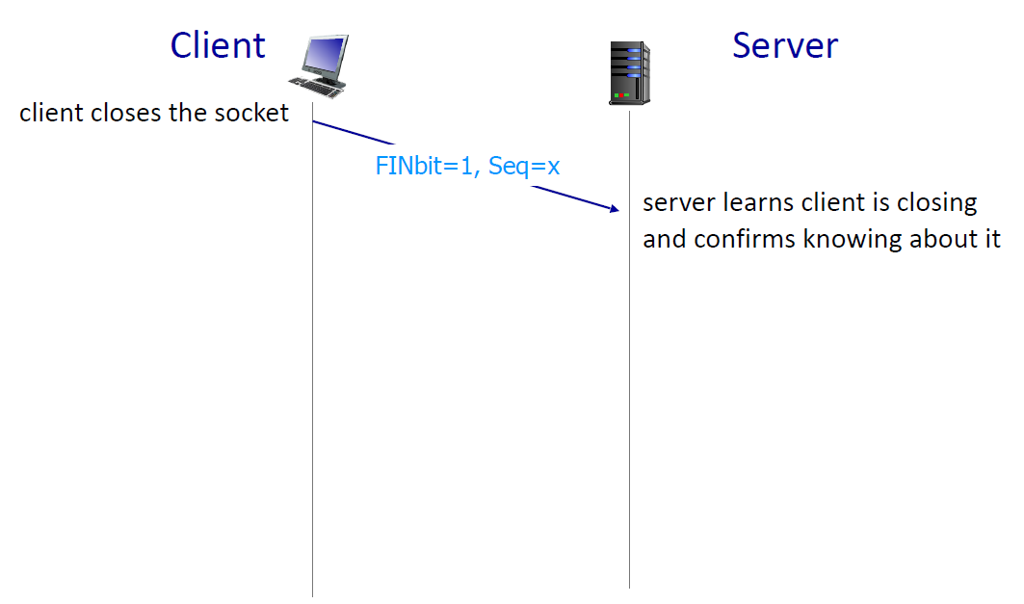
Closing a TCP connection

Slide 80
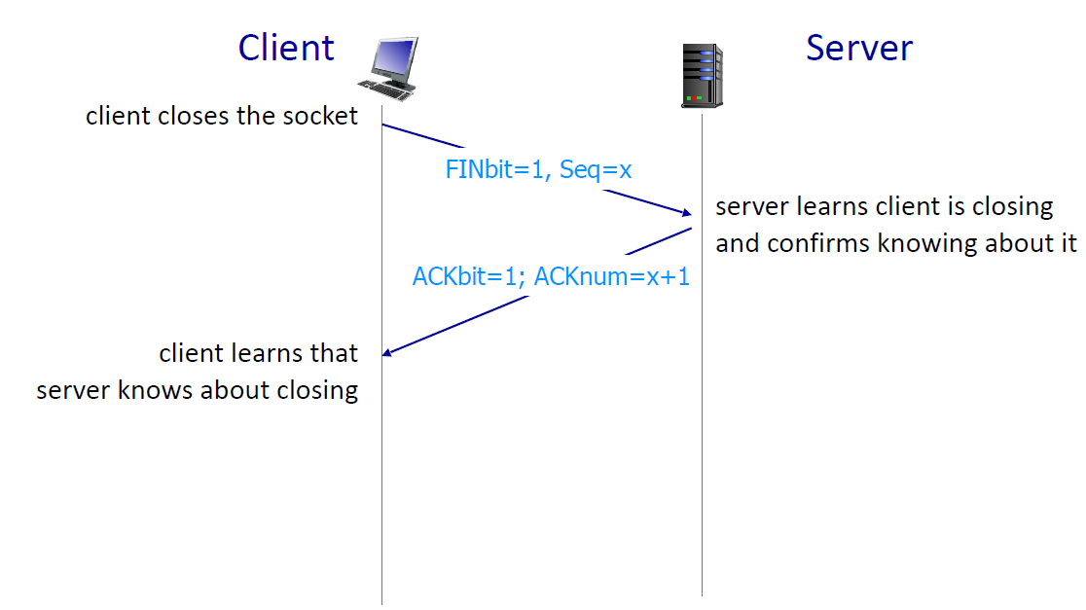
Closing a TCP connection

Slide 81
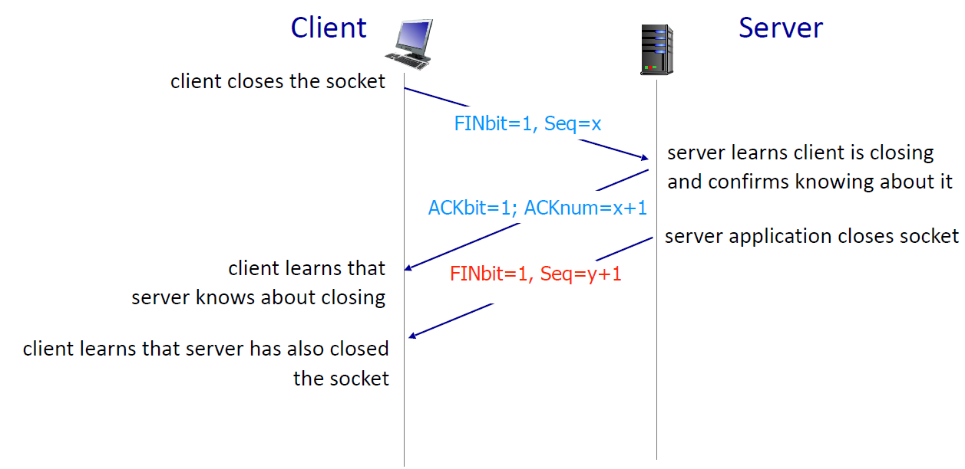
Closing a TCP connection

Slide 82
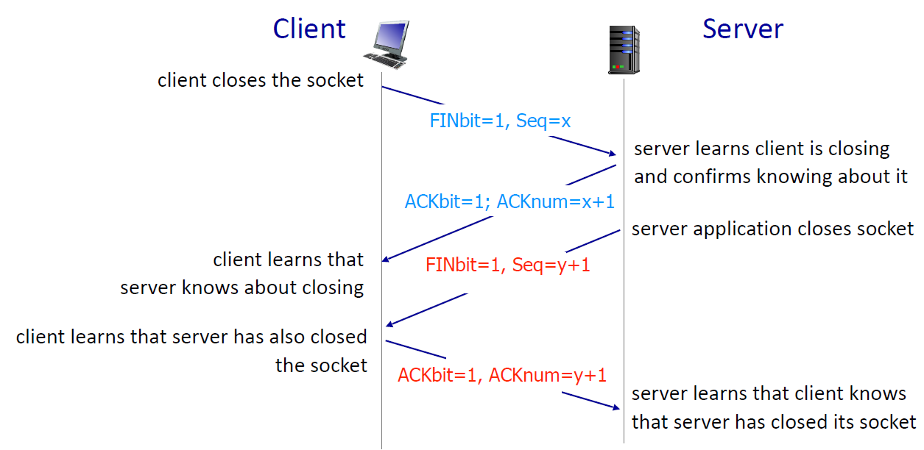
Closing a TCP connection

Slide 83
TCP flow control
application
process
Q: What happens if network layer delivers data faster than application layer removes data from socket buffers?
Application removing data from TCP socket buffers
TCP socket
receiver buffers
TCP
code
Network layer delivering IP datagram payload into TCP socket buffers
IP
code
from sender
receiver protocol stack

Slide 84


TCP flow control
application
process
Q: What happens if network layer delivers data faster than application layer removes data from socket buffers?
Application removing data from TCP socket buffers
TCP socket
receiver buffers
TCP
code
Network layer delivering IP datagram payload into TCP socket buffers
IP
code
from sender
receiver protocol stack

Slide 85
TCP flow control
application
process
Q: What happens if network layer delivers data faster than application layer removes data from socket buffers?
Application removing data from TCP socket buffers
TCP socket
receiver buffers
TCP
code
receive window
flow control: # bytes receiver willing to accept
IP
code
from sender
receiver protocol stack

Slide 86
TCP flow control
application
process
Q: What happens if network layer delivers data faster than application layer removes data from socket buffers?
Application removing data from TCP socket buffers
TCP socket
receiver buffers
TCP
code
flow control
receiver controls sender, so sender won’t overflow receiver’s buffer by transmitting too much, too fast
IP
code
from sender
receiver protocol stack

Slide 87
TCP flow control
flow control: # bytes receiver willing to accept
TCP receiver “advertises” free buffer space in rwnd field in TCP header
RcvBuffer size set via socket options (typical default is 4096 bytes)
many operating systems auto-adjust RcvBuffer
sender limits amount of unACKed (“in-flight”) data to received rwnd
guarantees receive buffer will not overflow
receive window
TCP segment format

Slide 88
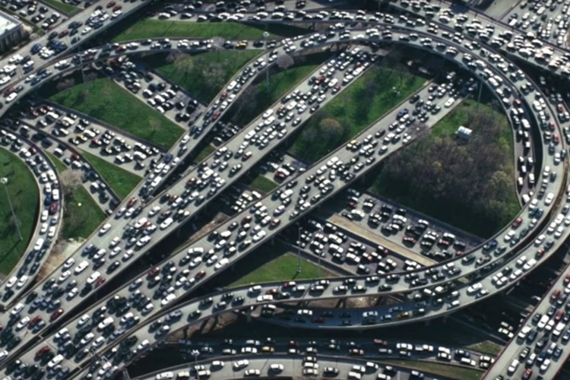
Principles of congestion control
Congestion:
informally: “too many sources sending too much data too fast for network to handle”
manifestations:
long delays (queueing in router buffers)
packet loss (buffer overflow at routers)
different from flow control!
congestion control: too many senders, sending too fast
a top-10 problem!
flow control: one sender too fast for one receiver

Slide 89
Approaches towards congestion control
End-end congestion control:
no explicit feedback from network
congestion inferred from observed loss, delay
ACKs
data
data
ACKs
approach taken by TCP
No help from inside the network

Slide 90
TCP congestion control: AIMD
(Additive Increase, Multiplicative Decrease)
approach: senders can increase sending rate until packet loss (congestion) occurs, then decrease sending rate on loss event
Additive Increase
Multiplicative Decrease
increase sending rate by 1 maximum segment size every RTT until loss detected
cut sending rate in half at each loss event
AIMD sawtooth
behavior: probing
for bandwidth
TCP sender Sending rate
time

Slide 91
TCP slow start
Host A
Host B
when connection begins, increase rate exponentially until first loss event:
initially cwnd = 1 MSS
double cwnd every RTT
done by incrementing cwnd for every ACK received
cwnd stands for Congestion Window and MSS = Maximum Segment Size → size of one data packet)
one segment
RTT
two segments
four segments
time
summary: initial rate is slow, but ramps up exponentially fast

Slide 92
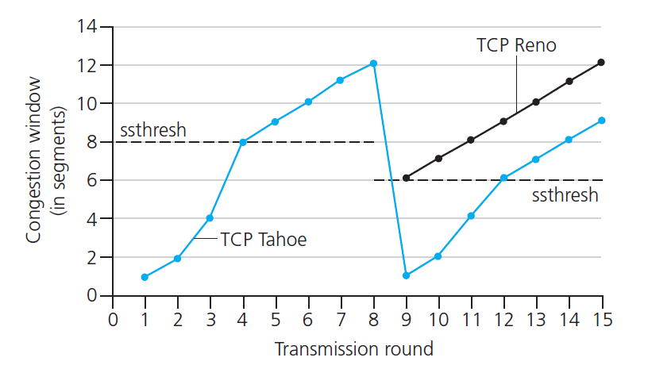
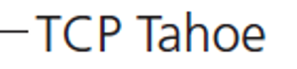
TCP: from slow start to congestion avoidance
Q: when should the exponential increase switch to linear?
A: when cwnd gets to 1/2 of its value before timeout.
X
Implementation:
variable ssthresh
on loss event, ssthresh is set to 1/2 of cwnd just before loss event

